Slide 1
QUALITY ASSURANCE TRAINING

Slide 2
Outline
Requirement Traceability Matrix (RTM)
The Concept of RTM in Software Testing
Developing Test Cases
Defect Reporting
Developing Test Report
Test Deliverables

Slide 3
Requirement Traceability Matrix(RTM)
Requirement Traceability Matrix or RTM captures all requirements proposed by the client or software development team and their traceability in a single document delivered at the conclusion of the life-cycle.
In other words, it is a document that maps and traces user requirement with test cases. The main purpose of Requirement Traceability Matrix is to see that all test cases are covered so that no functionality should miss while doing Software testing.

Slide 4
The Concept of Requirement Traceability Matrix in Software Testing
Let's understand the concept of Requirement Traceability Matrix through a Guru99 banking project.
On the basis of Business Requirement Document (BRD) and Technical Requirement Document (TRD), testers start writing test cases.
Let suppose, the following table is our Business Requirement Document or BRD for Guru99 banking project.
Here the scenario is that the customer should be able to login to Guru99 banking website with the correct password and user#id while manager should be able to login to the website through customer login page.

Slide 5
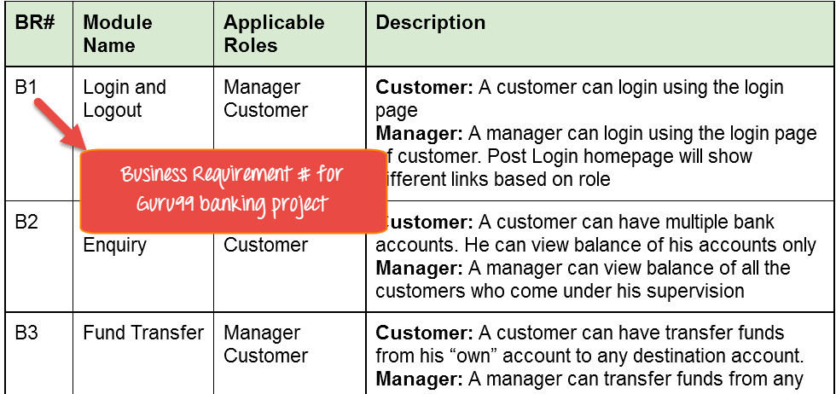
How to develop Requirement Traceability Matrix cont’d

Slide 6
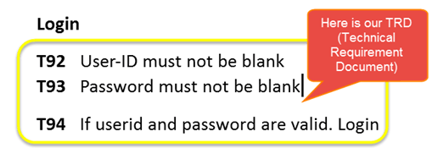
How to develop Requirement Traceability Matrix cont’d
While the below table is our Technical Requirement Document (TRD).
Note: QA teams do not document the BRD and TRD. Also some companies use Function Requirement Documents (FRD) which are similar to Technical Requirement Document but the process of creating Traceability Matrix remains the same.

Slide 7
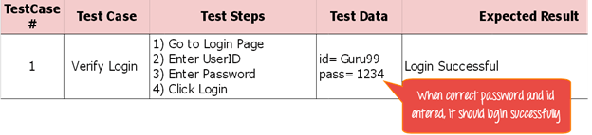
How to develop Requirement Traceability Matrix cont’d
Let's Go Ahead and create RTM Testing
Step 1: Our Test Case is
"Verify Login, when correct ID and Password is entered, it should login successfully"

Slide 8
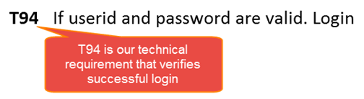
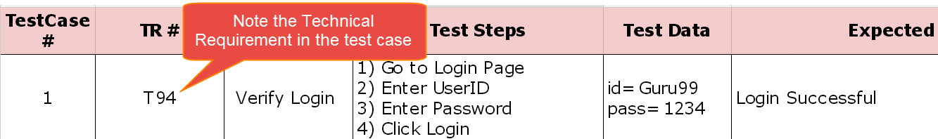
How to develop Requirement Traceability Matrix cont’d
Step 2: Identify the Technical Requirement that this test case is verifying. For our test case, the technical requirement is T94 is being verified.
Step 3: Note this Technical Requirement (T94) in the Test Case.

Slide 9
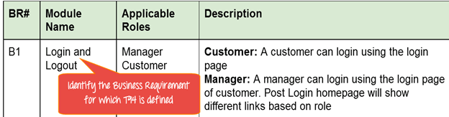
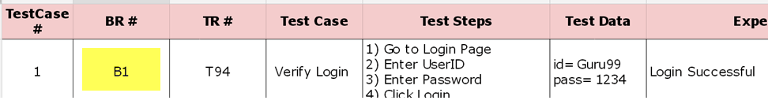
How to develop Requirement Traceability Matrix cont’d
Step 4: Identify the Business Requirement for which this TR (Technical Requirement-T94) is defined
Step 5: Note the BR (Business Requirement) in Test Case

Slide 10
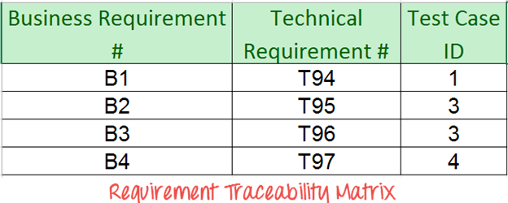
How to develop Requirement Traceability Matrix cont’d
Step 6: Do above for all Test Cases. Later Extract the First 3 Columns from your Test Suite. RTM in testing is Ready!

Slide 11
How to develop Requirement Traceability Matrix cont’d
Advantage of Requirement Traceability Matrix
It confirms 100% test coverage
It highlights any requirements missing or document inconsistencies
It shows the overall defects or execution status with a focus on business requirements
It helps in analyzing or estimating the impact on the QA team's work with respect to revisiting or re-working on the test cases

Slide 12
Developing Test Cases
Test Condition:
An item or event of a component or system that could be verified by one or more test cases e.g. a function, transaction, feature, quality attribute, or structural element.
Test Cases:
A set of input values, execution preconditions, expected results and execution post conditions, developed for a particular objective or test condition such as to exercise a particular program path or to verify compliance with a specific requirement.

Slide 13
Developing of Test Cases Cont’d
Test Case ID | BU_001 |  | Test Condition |  | Test the Login Functionality in Banking
Test Case Desc | Verify on entering valid userid and password, the customer can login
Step # | Step Details | Expected Result | Expected Result | Actual Results | Actual Results | Pass/Fail/Not executed/Suspended
1 | Navigate to http://demo.guru99.com | Site should open |  | As Expected |  | Pass
2 | Enter Userid & Password | Credential can be entered |  | As Expected |  | Pass
3 | Click Submit | Customer is logged in |  | As Expected |  | Pass

Slide 14
Defect Reporting
What is Bug?
A bug is the consequence/outcome of a coding fault
What is Defect?
A defect is a variation or deviation from the original business requirements
These two terms have very thin line of differnce, In the Industry both are faults that need to be fixed and so interchangebaly used by some of the Testing teams.
When a tester executes the test cases, he might come across the test result which is contradictory to expected result. This variation in the test result is referred as a Software Defect. These defects or variation are referred by different names in a different organization like issues, problem, bug or incidents.

Slide 15
Defect Reporting Cont’d
While reporting the bug to developer, your Bug Report should contain the following information
Defect_ID - Unique identification number for the defect.
Defect Description - Detailed description of the Defect including information about the module in which Defect was found.
Version - Version of the application in which defect was found.
Steps - Detailed steps along with screenshots with which the developer can reproduce the defects.
Date Raised - Date when the defect is raised
Reference- where in you Provide reference to the documents like . requirements, design, architecture or maybe even screenshots of the error to help understand the defect

Slide 16
Defect Reporting Cont’d
Detected By - Name/ID of the tester who raised the defect
Status - Status of the defect , more on this later
Fixed by - Name/ID of the developer who fixed it
Date Closed - Date when the defect is closed
Severity which describes the impact of the defect on the application
Priority which is related to defect fixing urgency. Severity Priority could be High/Medium/Low based on the impact urgency at which the defect should be fixed respectively

Slide 17
Supporting document for Defect
Defect Header
Date
Defect #
Application Name Screen Name
Screenshot (Y/N)
Submitted By
Reference
Date
Software version
Severity
Priority

Slide 18
Supporting document for Defect Cont’d
Defect Description
Module Name
Steps followed
Desired Results
Screen shots

Slide 19
Developing Test Report
Test Summary Report:
A document summarizing testing activities and results. And it may contain the following items
Project Name
Version history
Table of Contents:- which includes
Introduction
Test Summary:-[Include basic information about what was tested and what happened.]
Project Name: [Project name]
System Name: [System name]
Version Number: [Version number]
Additional Comments: [Enter any additional comments]

Slide 20
Developing Test Report Cont’d
Test Type:-[Include basic information about what was tested and what happened.]
Test Owner: [John Doe]
Test Date: [mm/dd/yyyy] - [mm/dd/yyyy]
Test Results: [Enter a summary of the test conducted and results]
Additional Comments: [Enter any summary comments]
Test Assessment
[Enter a comprehensive assessment of your interpretation of how adequate the test was in light of how thorough the test plan said it should be? What wasn't tested well enough?]
Test Results
[Summarize the test results. Include a detailed description of any deviations from the original test plan, design, test case, or expected results. Include any issues or bugs discovered during the test.]

Slide 21
Developing Test Report Cont’d
Test Assessment
[Enter a comprehensive assessment of your interpretation of how adequate the test was in light of how thorough the test plan said it should be? What wasn't tested well enough?]
Test Results
[Summarize the test results. Include a detailed description of any deviations from the original test plan, design, test case, or expected results. Include any issues or bugs discovered during the test.]
SuggEstED aCTIONS/RECOMMENDATION
[Describe what actions are suggested upon completion of this test?]

Slide 22
Developing Test Report Cont’d
Appendix A: Test Summary Report Approval
The undersigned acknowledge they have reviewed the <Project Name> Test Summary Report and agree with the approach it presents. Changes to this Test Summary Report will be coordinated with and approved by the undersigned or their designated representatives.
[List the individuals whose signatures are desired. Examples of such individuals are Quality Manager or Tester. Add additional lines for signature as necessary. Although signatures are desired, they are not always required to move forward with the practices outlined within this document.]
Signature: |  | Date:
Name:
Title:
Role:

Slide 23
Developing Test Report Cont’d
APPENDIX B: REFERENCES
[Insert the name, version number, description, and physical location of any documents referenced in this document.]
The following table summarizes the documents referenced in this document
Document Name and Version | Description | Location
<Document Name and Version Number> | [Provide description of the document] | <URL or Network path where document is located>

Slide 24
Developing Test Report Cont’d
APPENDIX C: KEY TERMS
[Insert terms and definitions used in this document.]
The following table provides definitions for terms relevant to this document.
Term | Definition
[Insert Term] | [Provide definition of the term used in this document.]
[Insert Term] | [Provide definition of the term used in this document.]
[Insert Term] | [Provide definition of the term used in this document.]

Slide 25
Test Deliverables
What is Test Deliverables
Test deliverable is any document/script/data related to testing which is handed over to client/stakeholder during or at the end of the testing phase. There are different test deliverables at every phase of the software development lifecycle. Some test deliverables are provided before testing phase, some are provided during the testing phase and some after the testing cycles is over.

Slide 26
Test Deliverables Cont’d
Below are some types of Test deliverables are:
Test cases Documents
Test Plan
Testing Strategy
Test Scripts
Test Data
Test Trace-ability Matrix
Test Results/reports
Test summary report
Install/config guides
Defect Report
Release notes Defect Report Release notes

Slide 27
The End
….Thank you

